Slide 1
Migratooor
embrace Scroll as your native chain
while rewarding your project’s more loyal users

Slide 2
Use-case
Token originally launched on L1 -> change to L2 as native-chain
Project may choose to

Slide 3



Benefits
Reward mechanichs
Gas Costs
Drive Community’s Engagement
Roll-up centric roadmap
Bring Visibility for Team’s long-term commitment and alignement
“Superchain Thesis” on Scroll ecosystem
Scroll Tech-stack advantages!

Slide 4

Solution
Project
User
sets
BRIDGES TO SCROLL
Rewards parameters
Incentivized Bridging
Locks L1 tokens
HODLer reward
zk-Proof of HODLed balances
deploys
New L2-native token contract
Claims Rewards

Slide 5
Features
PROJECT
Off-the-shelf inter-chain L2-native token thanks to CCIP integration
Freedom of choice for rewarded token
Convenient snapshot tool
USER
zk-Verifiability of HODLer Rewards

Slide 6
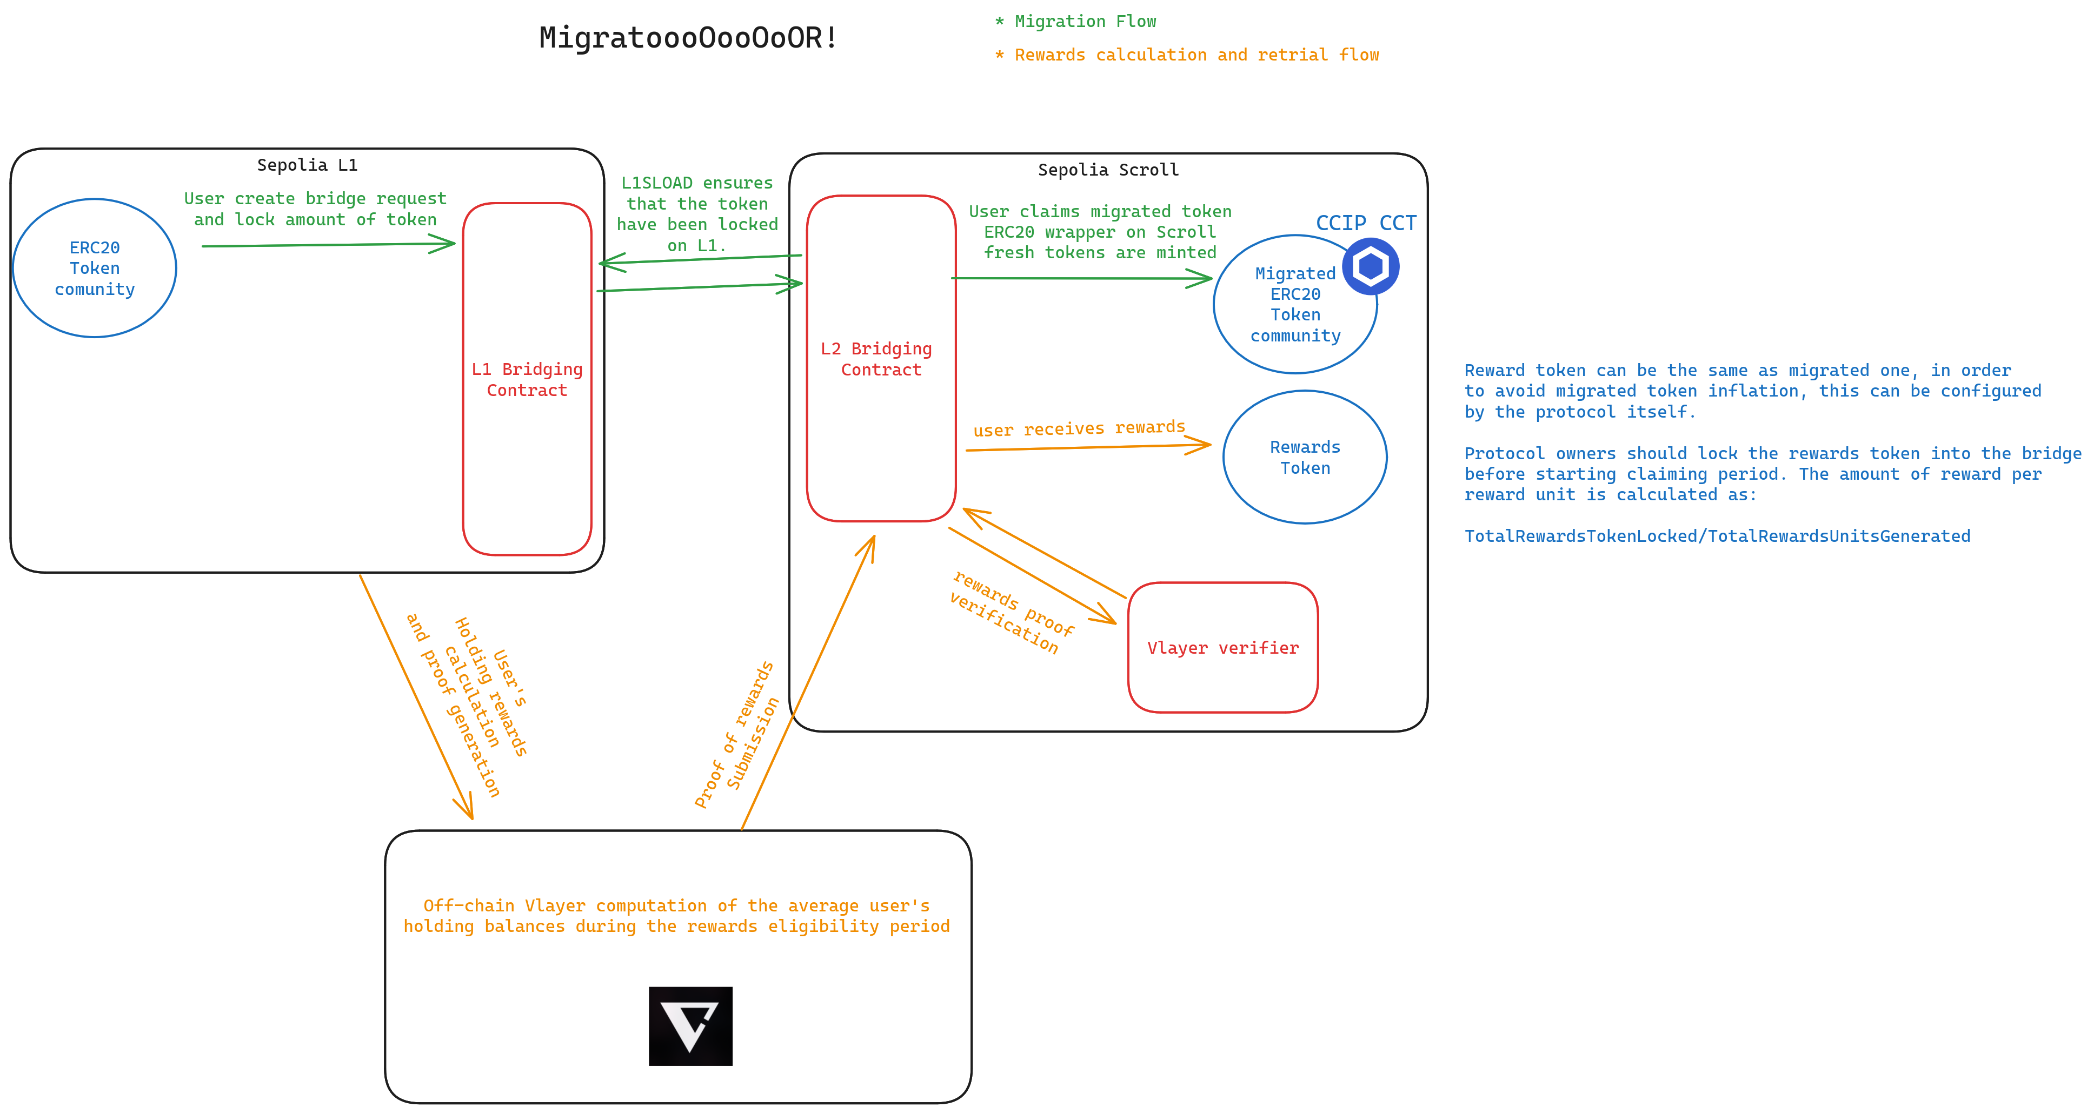
Implementation

